Slide 1
Year 2 SATs 2024 Information for Parents and Carers

Slide 2
What are SATs?
*National Curriculum Assessments, commonly known as SATs are carried out in the Summer Term to
help inform teachers’ judgements of KS1 pupils’
attainment.
* In 2017, it was confirmed that the KS1 SATs will be non-statutory (so schools will be able to choose whether to administer them or not) from 2024.
*Like most schools, Canon Popham feels the KS1 SATs still offer a very useful point for us to assess children’s attainment and progress.

Slide 3
*Unlike the SATs in Year 6, Year 2 SATs form only part of a final judgement made of each child by their class teacher, for each subject assessed.
*Teachers generally try to keep the assessment procedure informal – the papers are not strictly timed, and are usually taken in a normal classroom situation to keep the pressure off children.
*Completed papers are marked internally.

Slide 4
*KS1 SATs are designed to evaluate your child’s attainment against year group expectations. They are not designed to be passed or failed but highlight where they are doing well and where perhaps, they need extra support.

Slide 5
How are KS1 SATs administered?
*The tests take place during normal school hours
*These assessments for KS1 take place during a 2 week period - week beginning June 17th – June 28^{th,} 2024.
*KS1 children are tested in maths and English: reading and spelling, punctuation and grammar (SPaG).
*Writing is assessed using evidence collected by your child’s teacher throughout Year 2 – there is no Year 2 writing test.

Slide 6
What sort of results are reported?
Once marked, the tests will be given the following scores:
*A raw score (the total number of marks achieved for each paper);
*A scaled score (which is explained next);
*A judgement of whether the National Standard has been met. After marking each test, we are required to convert each raw score into a scaled score to show whether each child is working below, towards, at or above the national standard (the latter also known as greater depth).

Slide 7
Reading
*Paper 1 is a combined reading prompt and answer booklet. The paper includes a list of useful words and practice questions for teachers to introduce the contexts and question types to pupils. The test takes approximately 30 minutes to complete, but it is not strictly timed.
*Paper 2 consists of an answer booklet and separate reading booklet. There are no practice questions on this paper. Teachers can use their discretion to stop the test early if a pupil is struggling. The test takes approximately 40 minutes to complete, but it is not strictly timed.

Slide 8
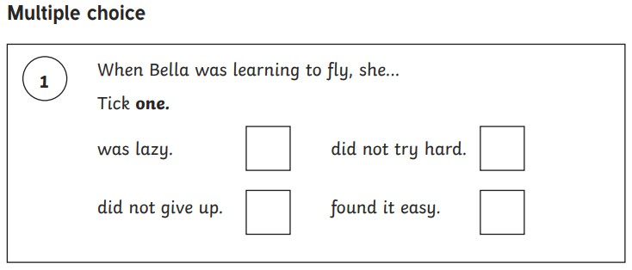
Question types:

Slide 9
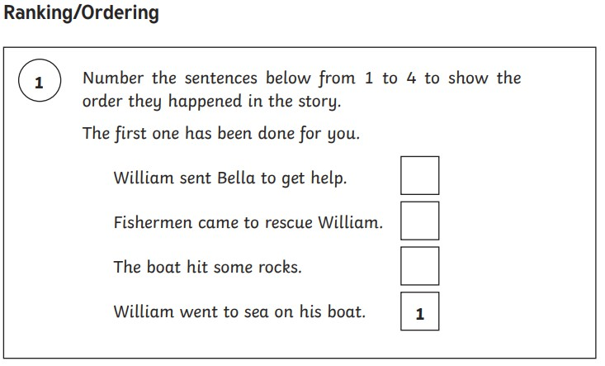
Question types:

Slide 10
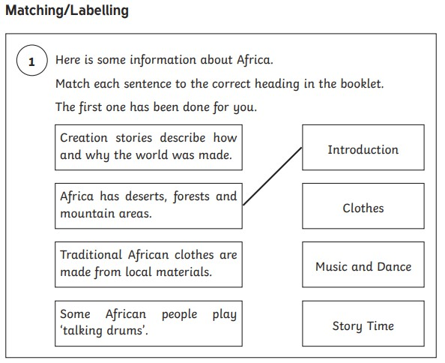
Question types:

Slide 11
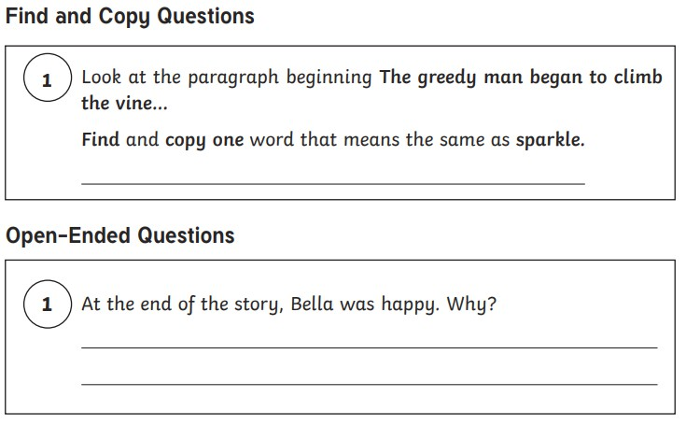
Question types:

Slide 12
Spelling, Punctuation and Grammar (SPaG)
*This test is optional (to schools not individuals) and used to inform teacher-assessed writing judgements. Canon Popham take this test.
*Paper 1 is a spelling test, where pupils spell 20 missing words, writing answers in a test booklet. It takes around 15 minutes, but is not strictly timed.
*Paper 2: Grammar, Punctuation and Vocabulary in a combined question and answer booklet. It takes around 20 minutes, but is not strictly timed.

Slide 13
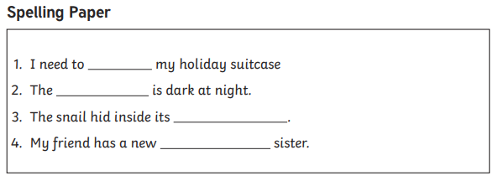
Question types:

Slide 14
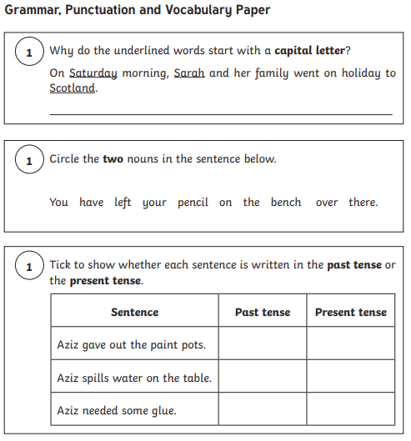
Question types:

Slide 15
Mathematics
*Paper 1: Arithmetic – covering calculation methods for all operations. It takes around 20 minutes, but is not strictly timed.
*Paper 2: Reasoning. It takes around 35 minutes, including 5 aural questions, but is not strictly timed. Pupils will still require calculations skills, but questions will be varied including multiple choice, matching, true/false, completing a table or chart or drawing a shape. Some questions will require children to show or explain their working out.

Slide 16
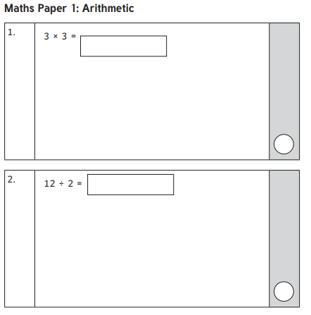
Question types:

Slide 17
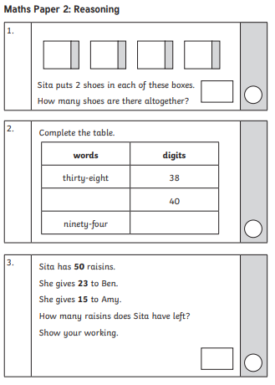
Question types:

Slide 18
How can parents help with SATs?
*Do not panic yourself, as this will make learning stressful and difficult for them. Reassure them there is nothing to worry about and to try their best. Praise and encourage!
*Teachers carry out these sorts of assessments
regularly throughout children’s school lives, so they are used to and well prepared for SATs. You can help by supporting your child with their homework.
Daily reading is particularly invaluable, in addition to keeping maths skills ticking over in our maths home learning.
*Ensure the best possible attendance at school and make sure your child has a good sleep and healthy breakfast each day.

Slide 19
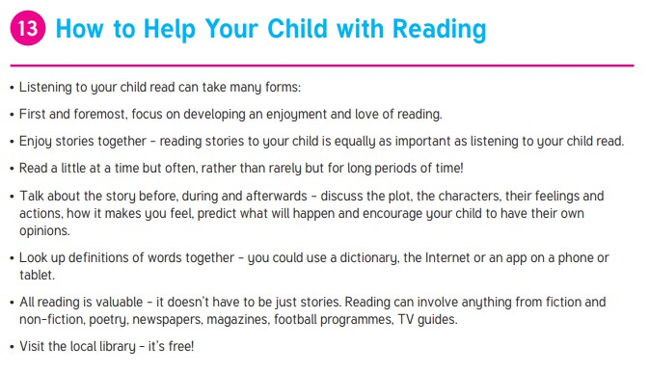

Slide 22
Any questions?

