Slide 2
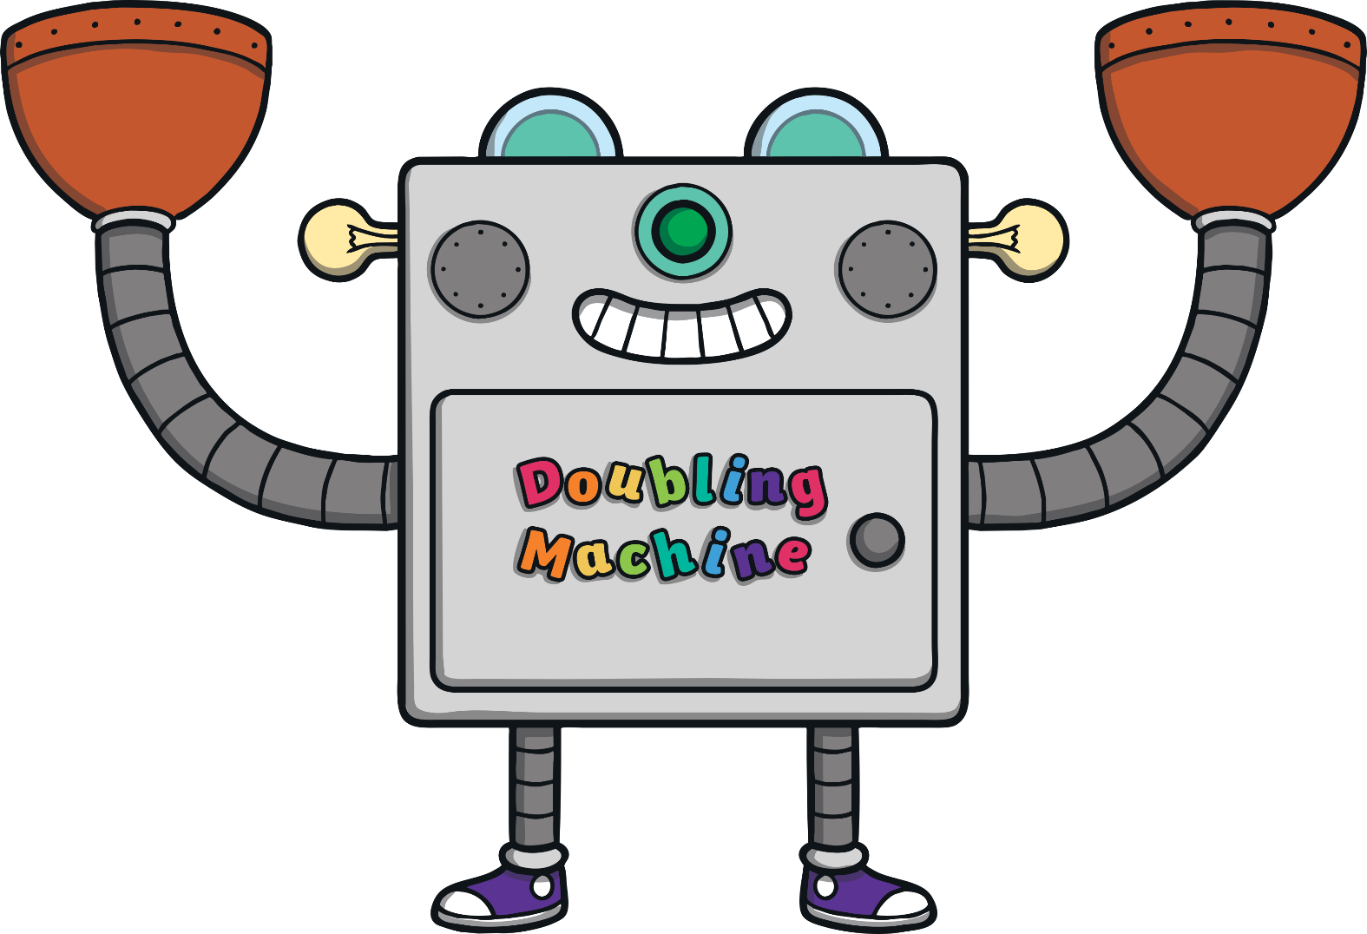
10
7 + 3 = ?
+
?
Show Answer

Slide 3
10
6 + 4 = ?
8
+
?
Show Answer

Slide 4
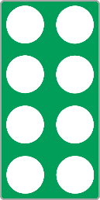
10
2 + 8 = ?
9
+
?
Show Answer

Slide 5
?
3 + ? = 10
7
+
Show Answer

Slide 6
?
? + 5 = 10
5
+
Show Answer

Slide 7
?
? + 10 = 10
0
+
Show Answer

Slide 8
10
4 + 6 = ?
+
?
Show Answer

Slide 9
8 + 2 = ?
10
+
?
Show Answer

Slide 10
9 + 1 = ?
10
+
?
Show Answer

Slide 11
?
10 + ? = 10
0
+
Show Answer

Slide 12
?
1 + ? = 10
9
+
Show Answer

Slide 13
?
? + 4 = 10
6
+
?
Show Answer

