Slide 2
OUR Year 2 team
Mrs Milnes – Year 2 teacher
Mrs Margetts – Teaching assistant
Mrs Watson – Teaching assistant
Miss Smith – Teaching assistant

Slide 3
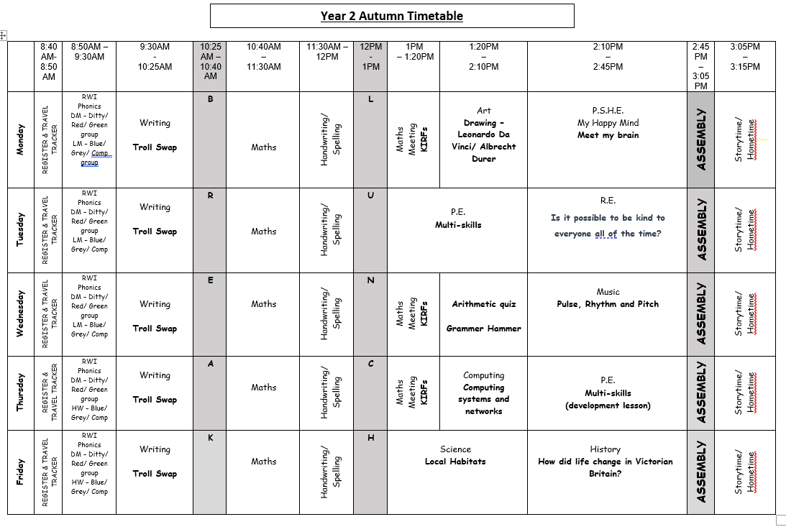
Year 2 timetable

Slide 4
Year 2 information
All information about our curriculum can be found on our Year 2 webpage. Click on the link to access.
www.canonpopham.co.uk/curriculum/our-class-pages-and-curriculum-planning/year-2
Please ensure all uniform and PE kit is named. There is a Uniform Policy on the school website. All children need to be wearing the correct uniform. This includes PE kit. No jewellery should be worn except for stud earrings. Nail polish should not be worn in school.
Please ensure lunchboxes, snack boxes and water bottles are all named.

Slide 5
Year 2 information
Reading books will be changed weekly, on a Friday. Please write in your child’s reading diary when you listen to them read at home. They should be reading to you at home at least three times a week. If your child reads twenty times in a month, they receive a GOLDEN TICKET!
Your child will take home 2 books each week – their reading book and a class library book. They have also been allocated a username and password for Oxford Owl to access the RWI books too. Weekly engagement with the online reading books will also be rewarded with a GOLDEN TICKET.

Slide 6
Year 2 information
Your child will have a log-in and password to enable them to access NUMBOTs to improve their arithmetic fluency skills. Weekly engagement with NUMBOTs will also be rewarded with a GOLDEN TICKET.
PE is on Tuesday afternoons. Children should arrive in the morning in their school uniform and after lunch they will change into their P.E. kit. All P.E. kit should be labelled. Long hair should be tied back and stud earrings removed or covered.

Slide 7
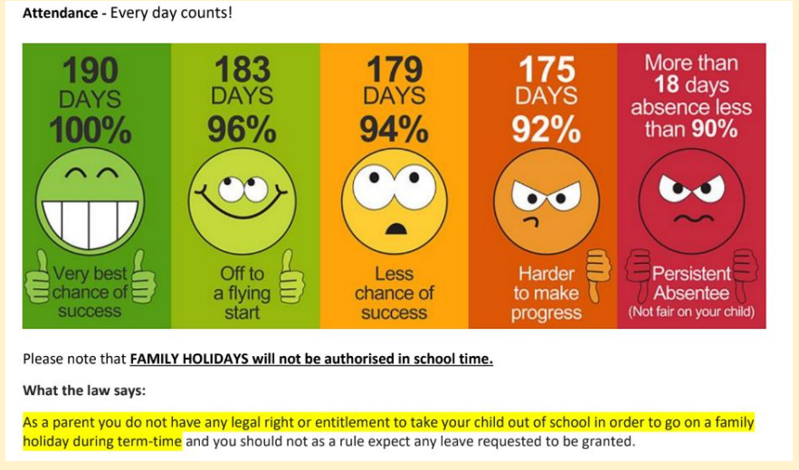
Attendance

Slide 8
OUR SCHOOL VALUES AND RULES
Our school has a strong Christian ethos built on our core Gospel values which the children focus upon each half term:
Endurance, Forgiveness, Thankfulness, Justice, Hope and Compassion.
Our school has three simple rules:
Ready, Respectful, Safe
All classes have a recognition board in their classroom with our school rules of READY, RESPECTFUL, SAFE. Every week there is a different focus for children to aim for and get their names onto the board. This will show that children have gone OVER and ABOVE in school that week. When they do get their names on the recognition board they will be rewarded with a GOLDEN TICKET.

Slide 9
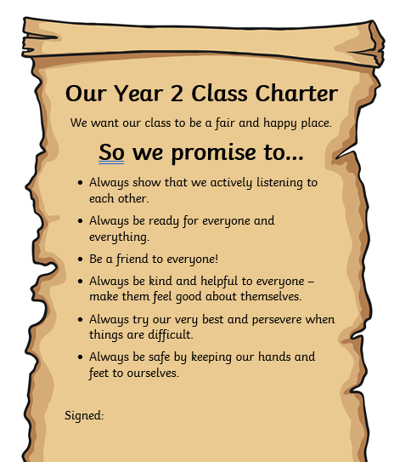
OUR CLASS CHARTER

Slide 10
Celebrating work
Writer of the Month
Let Your Light Shine - Thursday
Two children will be chosen for a wide range of reasons such as:
Having a positive attitude to their learning, resilience, teamwork, following school rules, being a good role model, presentation of work, being a good friend, upholding the school mission statement etc
One child is chosen for their efforts in writing each half term.
Work is displayed in the hall for all to read.
The children are awarded with an age-appropriate reading book of their choice.
NUMBOTs
Children will receive a certificate when they reach specific levels presented to them in Thursday’s assembly.

Slide 11
Celebrating work
Teachers give children house points to acknowledge outstanding effort or acts of kindness in school.
House points are given to children also for consistent good effort or good work.
Each class has a house point system, where accumulated points are added to the school’s house points. Each child is allocated a house: St Andrew, St George, St Patrick or St David, The house with the most house points for that week is announced in Let Your Light Shine assembly.

Slide 12
Please let us know if a different person than usual is collecting your child, even if it is another parent who is known to us.
• We are around at the beginning and end of the school day for quick queries. If you need to speak to us for a longer meeting, please arrange an appointment with the class teacher in the first instance.
If your child requires an inhaler this should be named and in school. Any information regarding your child e.g. allergy, background information then please speak to myself or any of our additional adults.
• Please remember that our school is a BANANA and NUT FREE school.
Our class email: year2@cpa.dsat.education

